Slide 1

Customer Churn Prediction
Presented By:
Jaiswal Vaibhav Rohitbhai (2203031250036)
Sane Harsh Balkrishna (2203031250084)
Ashish Thomas John (2203031250011)
Adithya Vinod (2203031250004)
Project Mentor:
Ankita Saxena

Slide 2
Abstract of Predicting Customer Churn
Customer churn—where customers stop using a company's services—is a critical issue that leads to lost revenue and higher customer acquisition costs. This project aims to develop a predictive model that can identify customers likely to churn by leveraging big data analytics and machine learning techniques.
Key Highlights:
The model will analyse customer behavioural patterns, usage data, and transaction history.
Machine learning algorithms will classify customers as “churn” or “non-churn” based on historical data.
This solution will help organizations take proactive measures to retain customers and optimize revenue.

Slide 3
Motivation for the Project
1. Real-World Challenge: High churn rates are costly for companies across industries like telecom, e-commerce, and banking. Retaining customers is 5x cheaper than acquiring new ones.
2. Value of Prediction: Companies need insights to predict churn early and implement customer retention strategies.
3. Interest in Data Analytics: With growing interest in machine learning and big data, this project allows us to apply analytical and modelling skills to solve a real-world business problem.
4. Career Relevance: Customer analytics is a sought-after field in data science, aligning with our career goals in big data analytics.

Slide 4
Flow of Project Execution
1. Data Collection
2. Data Preprocessing
3. Exploratory Data Analysis (EDA)
4. Model Development and Evaluation
5. Frontend Deployment
6. {Feature} Insights & Recommendations
7. List of Research Papers

Slide 5
Flow of Project Execution (Details)
1. Data Collection
- Gather large-scale historical data (e.g., customer transactions, usage history, demographics).
- Data sources: company databases, open datasets (Kaggle), or simulated data.
2. Data Preprocessing
- Clean the data: Handle missing values, outliers, and duplicates.
- Feature engineering: Create new features like “average purchase frequency” or “time since last transaction.”
- Normalize and transform data for model training.

Slide 6
Flow of Project Execution (Details)
3. Exploratory Data Analysis (EDA)
- Analyse data patterns to understand key factors contributing to churn.
- Visualizations: Customer trends, behaviour metrics, churn vs. non-churn comparisons.
4. Model Development
- Use machine learning algorithms to develop the predictive model.
- Logistic Regression (baseline model).
- Random Forest and XGBoost (for accuracy improvements).
- Deep Learning Models.
- Split data into training and testing datasets for model evaluation.

Slide 7
Flow of Project Execution (Details)
5. Model Evaluation & Selection:
- Evaluate model performance: Use metrics like accuracy, precision, recall, F1-score, AUC-ROC.
- Compare models: Select the model with the best performance and the most suitable trade-off between accuracy and interpretability.
6. Deployment
- Deploy the model to predict churn on new data (e.g., a cloud platform like firebase will be used.).
7. Insights & Recommendations
- Identify high-risk customers.
- Suggest actionable strategies: Loyalty programs, targeted campaigns, or personalized offers.

Slide 8
Innovation Modules in this Project
Scalable and Efficient:
The use of big data analytics allows the system to handle massive datasets effectively, ensuring scalability.
Model Optimization:
Implement ensemble techniques (e.g., Random Forest or XGBoost) to achieve high predictive accuracy.
Insights Beyond Prediction:
Not just predicting churn but identifying the key drivers of churn using feature importance analysis.

Slide 9
Innovation Modules in this Project
Customer-Centric Strategies:
Provide actionable recommendations that organizations can immediately deploy to reduce churn rates.
Future Enhancements:
Incorporate real-time predictions using streaming platforms like Apache Kafka for industries like telecom.

Slide 10
Implementation of Project
By:- Adithya Vinod

Slide 11
Implementation of Project
1. Dataset Overview
• Data Source: WA_Fn-UseC_-Telco-Customer-Churn.csv
• Total Records: 7043 customers
• Features: 21 (e.g., Gender, Tenure, Contract Type, Payment Method)
• Target Variable: Churn (Yes/No)
• Link: Click Here

Slide 12
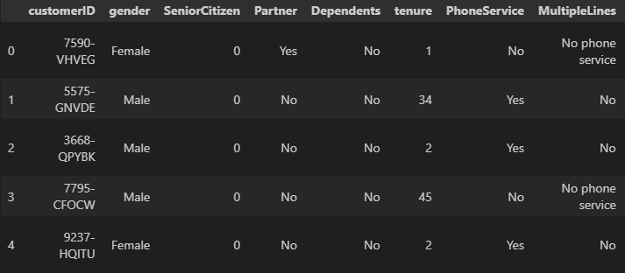
Implementation of Project
1. Dataset Overview

Slide 13
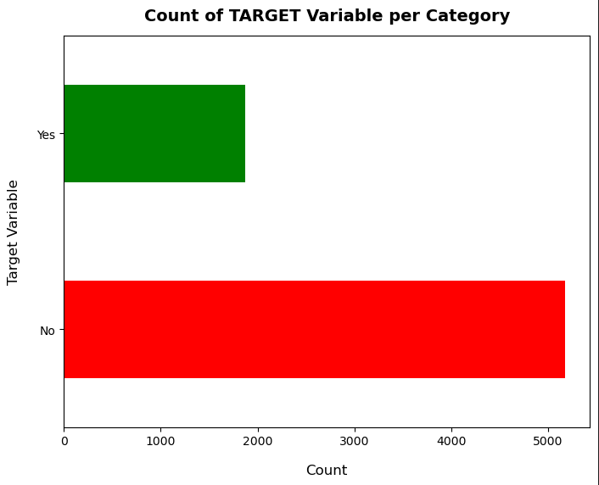
Implementation of Project
1. Dataset Overview

Slide 14
Implementation of Project
2. Data Preprocessing
Handling Missing Values:
-missing values in 'TotalCharges' (0.15% of data) were dropped.
Data Type Conversion:
- Converted 'TotalCharges' from object to numeric.
Feature Engineering:
- Created tenure groups (1-12, 13-24, etc.).
- Dropped 'CustomerID' and 'Tenure'.
Categorical Encoding:
- Applied one-hot encoding for categorical features.
Target Variable Transformation:
- Converted 'Churn' into binary format (Yes=1, No=0).

Slide 15
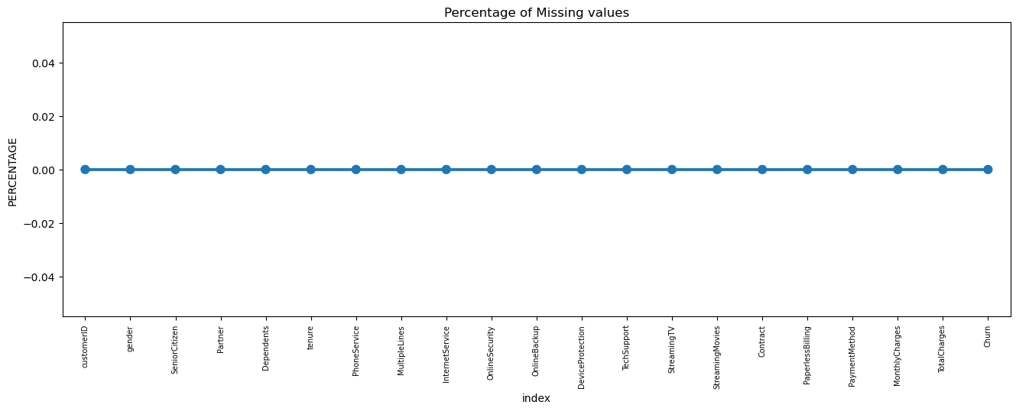
Implementation of Project
2. Data Preprocessing

Slide 16
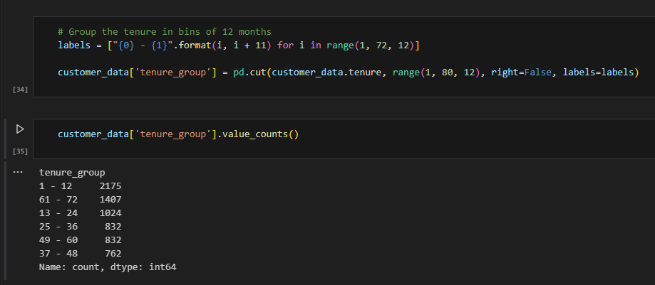
Implementation of Project
2. Data Preprocessing

Slide 17
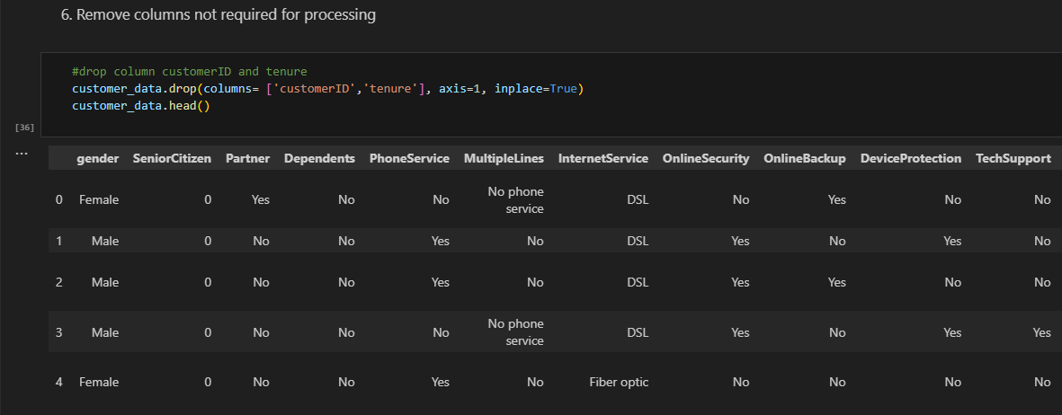
Implementation of Project
2. Data Preprocessing

Slide 18
Implementation of Project
3. Exploratory Data Analysis
1. Churn Distribution:
- Imbalanced: 73% No Churn, 27% Churn.
2. Churn Trends:
- Higher churn in month-to-month contracts & electronic check payments.
3. Tenure vs. Churn:
- Customers with tenure <12 months churn the most.
4. Monthly & Total Charges Impact:
- Higher Monthly Charges → Higher Churn.
- Lower Total Charges → Higher Churn.
5. Feature Correlation:
- Churn is strongly linked to contract type & support services.

Slide 19
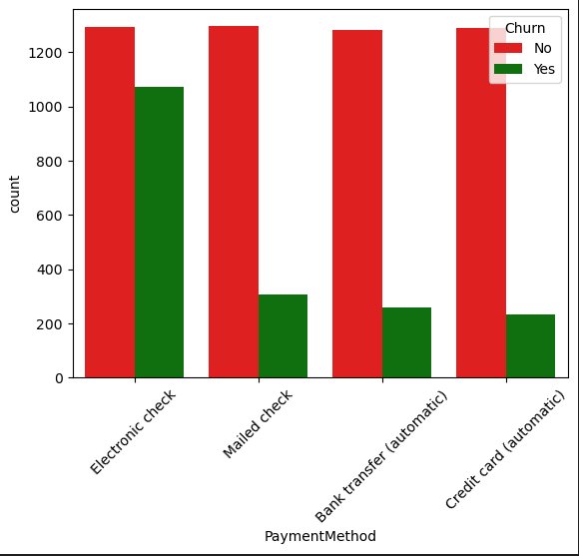
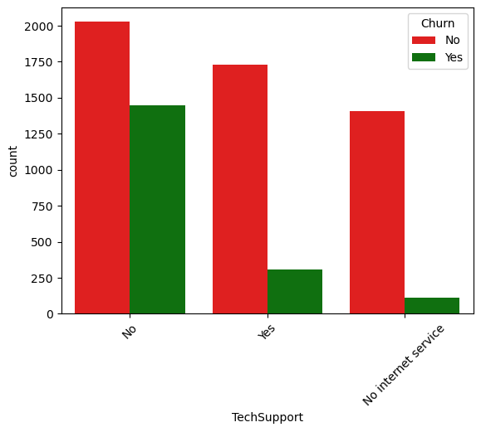
Implementation of Project
3. Exploratory Data Analysis

Slide 20
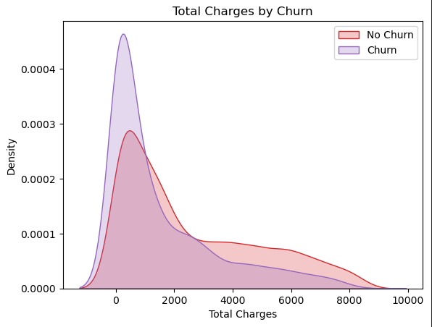
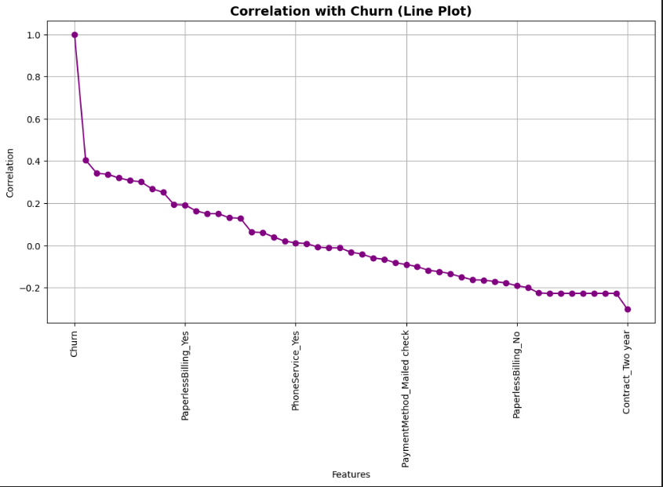
Implementation of Project
3. Exploratory Data Analysis

Slide 21
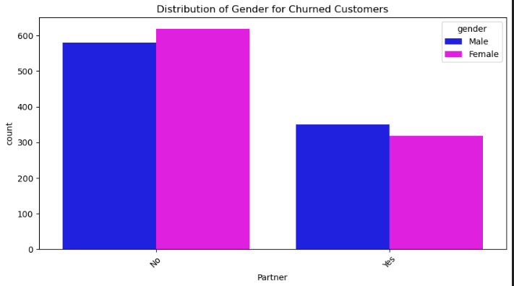
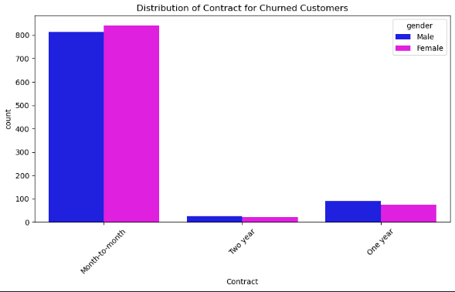
Implementation of Project
3. Exploratory Data Analysis

Slide 22
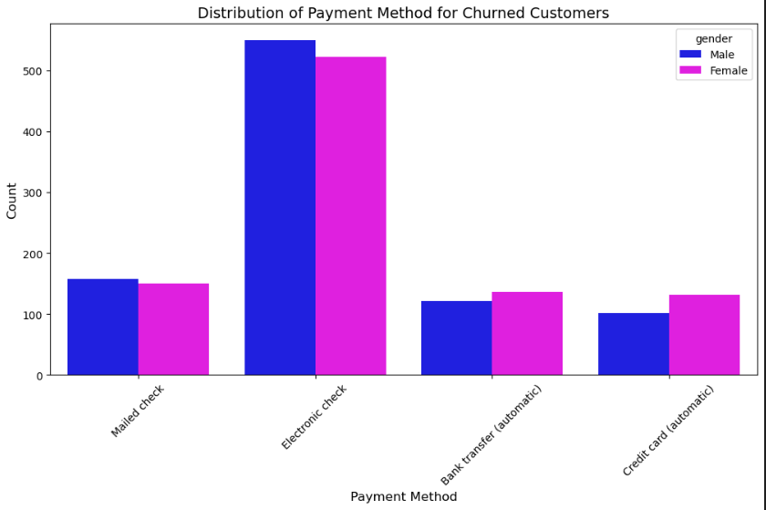
Implementation of Project
3. Exploratory Data Analysis

Slide 23
Model Development and Evaluation
By:- Ashish Thomas John

Slide 24
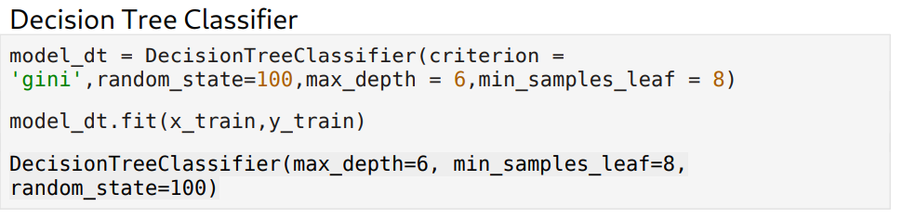
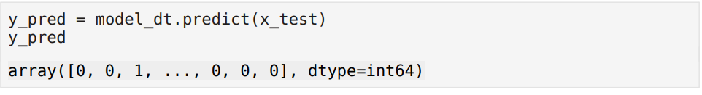
Model Development and Evaluation
Model 1: Decision Tree Classifier

Slide 25
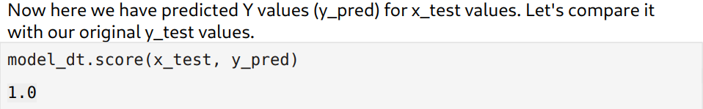
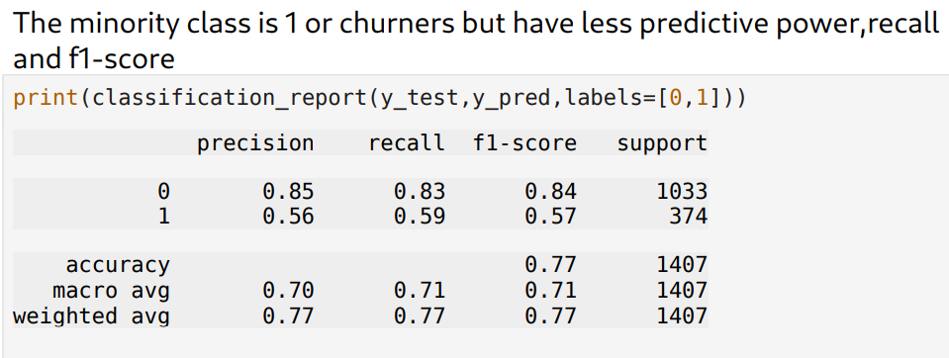
Model Development and Evaluation
Model 1: Decision Tree Classifier

Slide 26
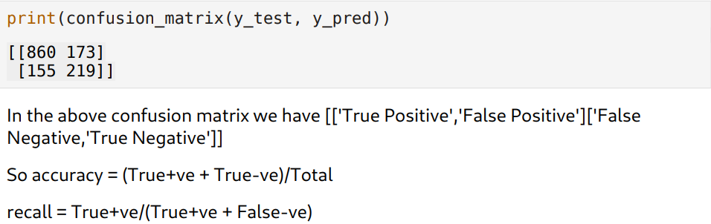
Model Development and Evaluation
Model 1: Decision Tree Classifier

Slide 27
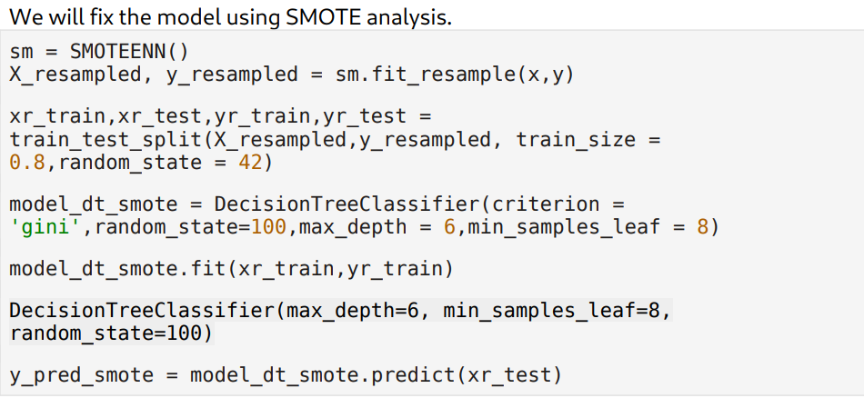
Model Development and Evaluation
Model 1: Decision Tree Classifier

Slide 28
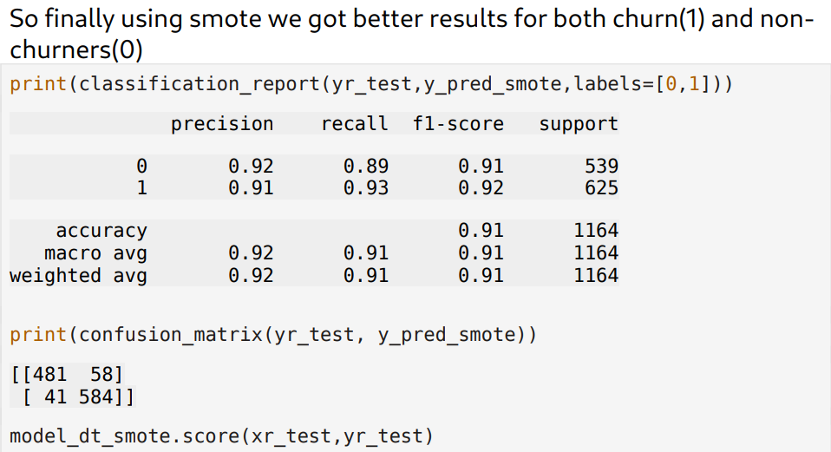
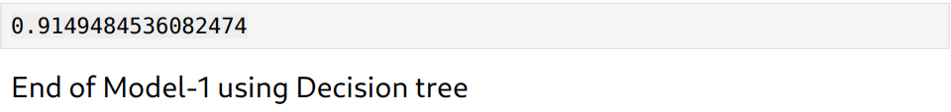
Model Development and Evaluation
Model 1: Decision Tree Classifier

Slide 29
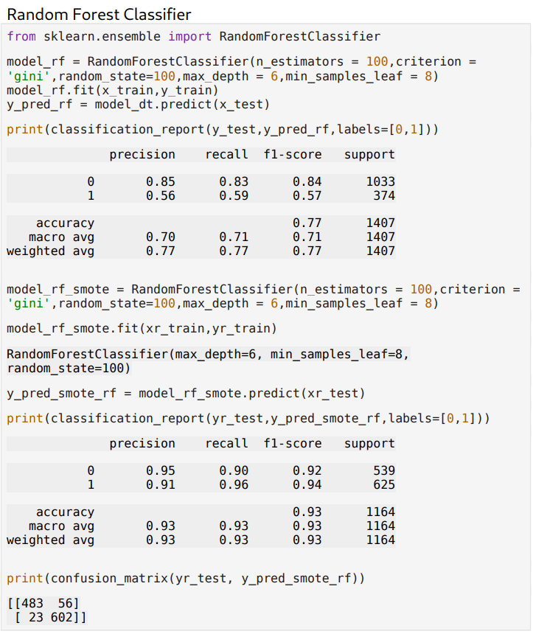
Model Development and Evaluation
Model 2: Random Forest Classifier

Slide 30
Model Development and Evaluation
Model 2: Random Forest Classifier

Slide 31
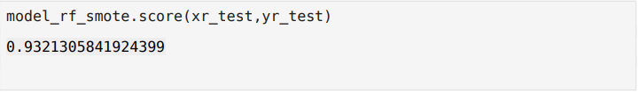
Model Development and Evaluation
Model 2: Random Forest Classifier

Slide 32
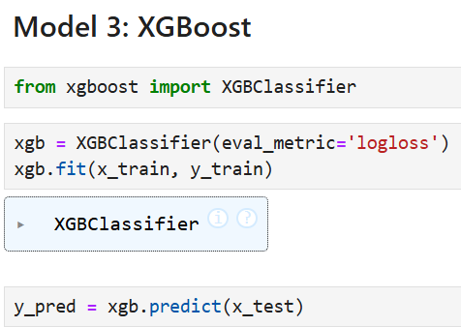
Model Development and Evaluation
Model 3: XG Boost

Slide 33
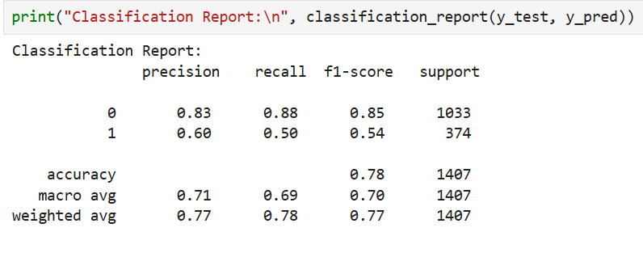
Model Development and Evaluation
Model 3: XG Boost

Slide 34
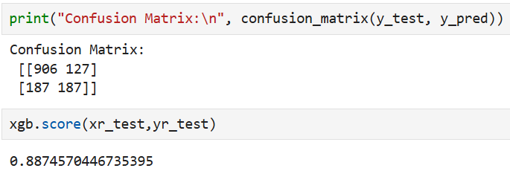
Model Development and Evaluation
Model 3: XG Boost

Slide 35
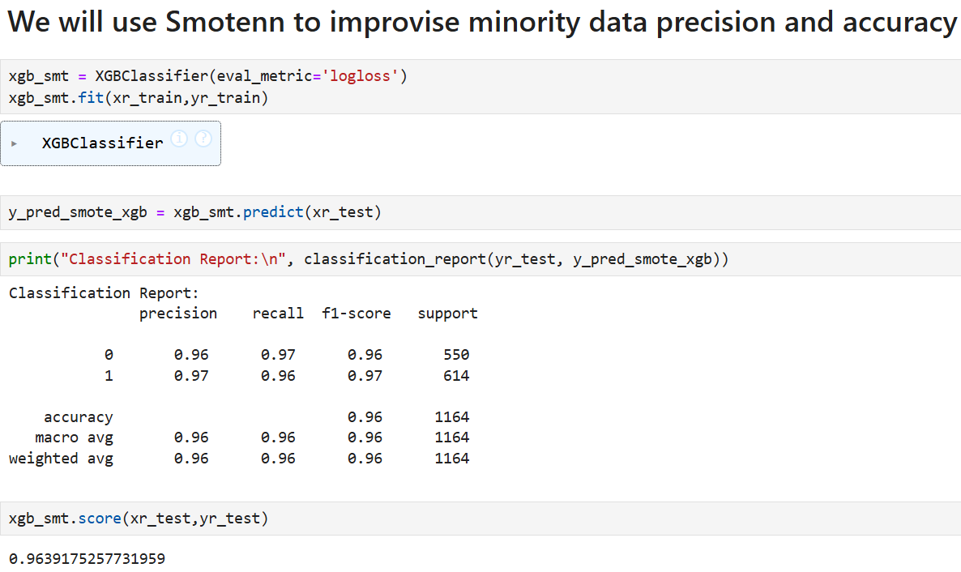
Model Development and Evaluation
Model 3: XG Boost

Slide 36
Model Development and Evaluation
Model 3: XG Boost

Slide 37
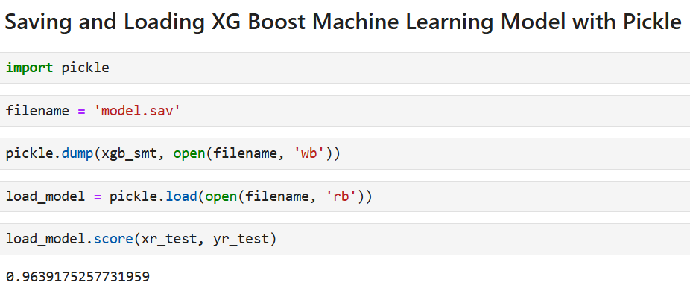
Model Development and Evaluation
Model 3: XG Boost

Slide 38
Frontend Deployment
By:- Sane Harsh Balkrishna

Slide 39
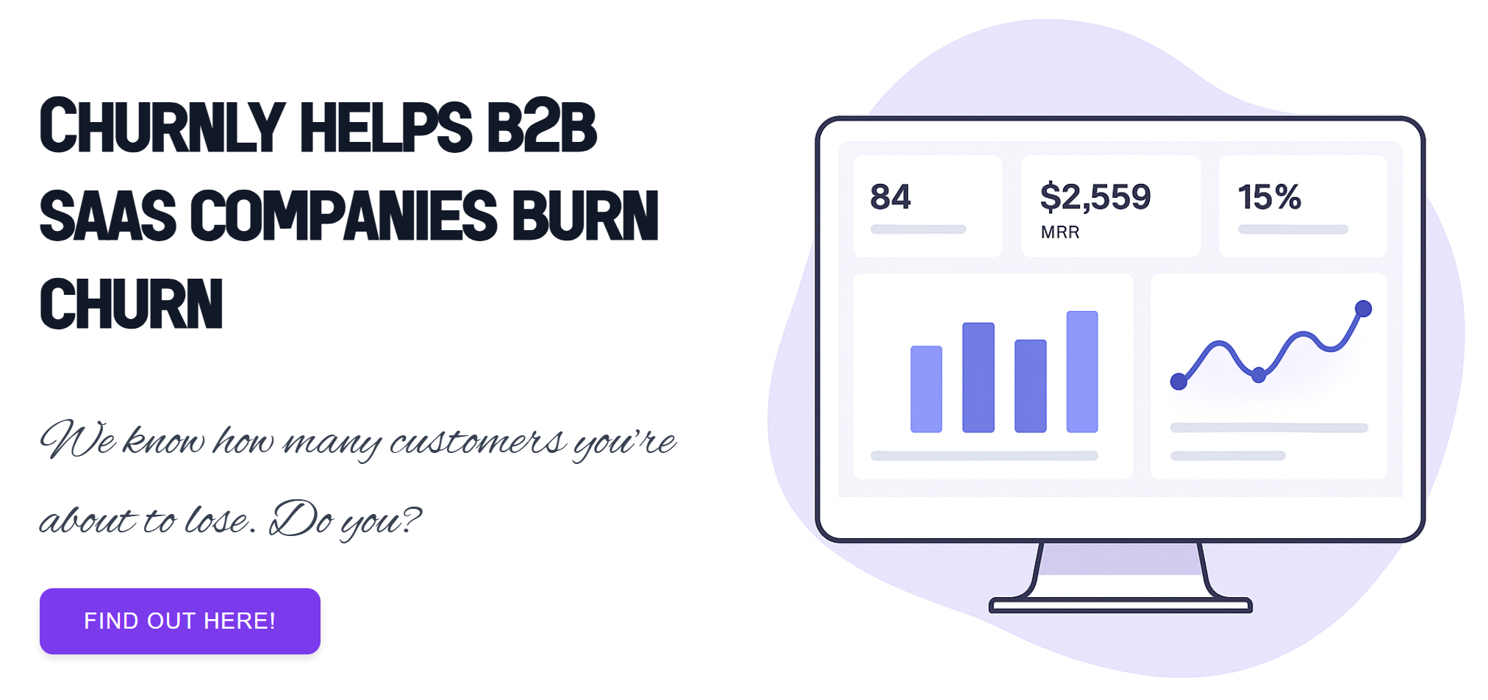
Frontend Deployment
Page-1 : Home Page

Slide 40
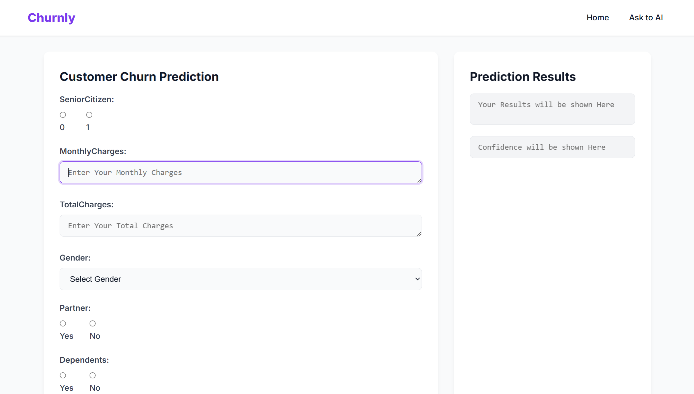
Frontend Deployment
Page-2 : Prediction Page {Before Submission}

Slide 41
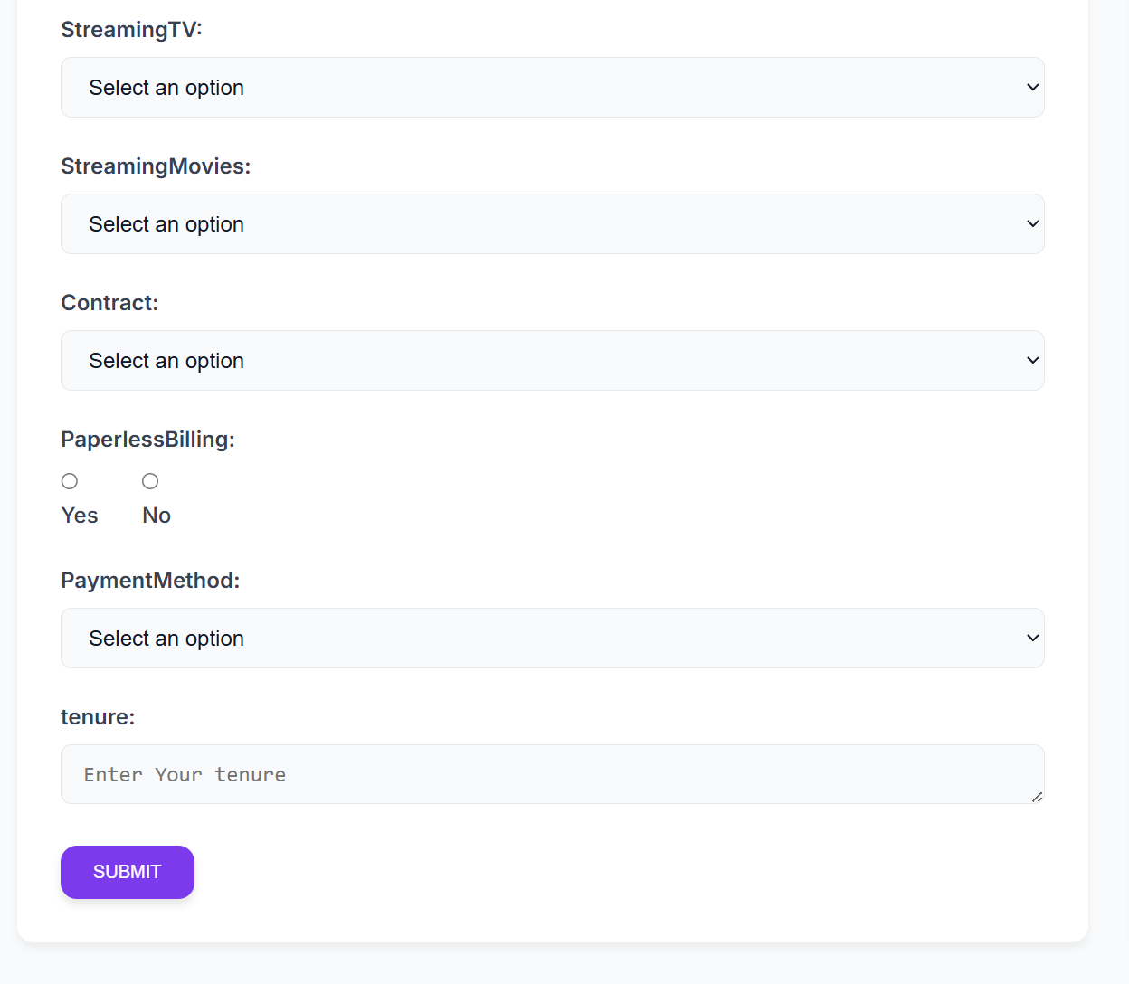
Frontend Deployment
Page-2 : Prediction Page {Continue}

Slide 42
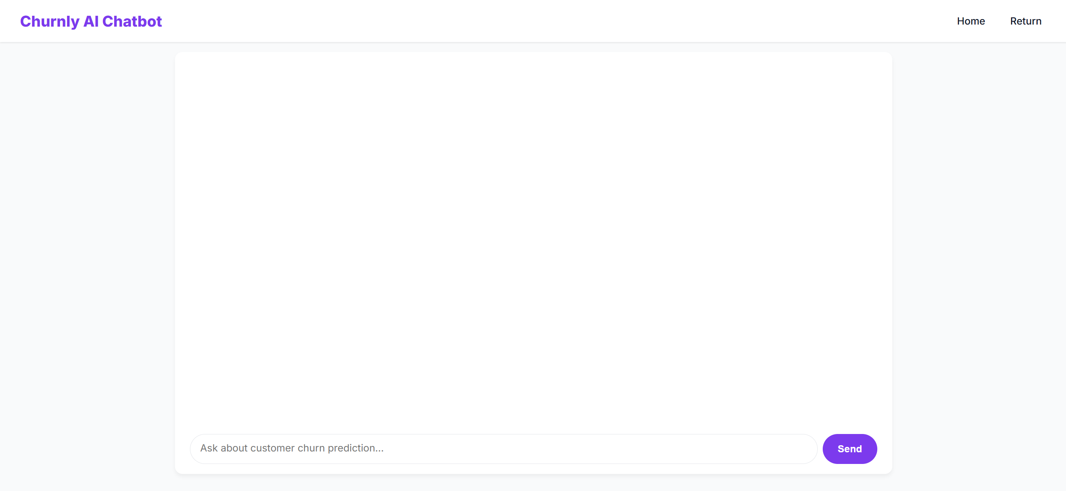
Frontend Deployment
Page-3 : AI Chat-Bot Page {Before Response}

Slide 43
{Feature} Insights and Recommendations
By:- Jaiswal Vaibhav Rohitbhai

Slide 44
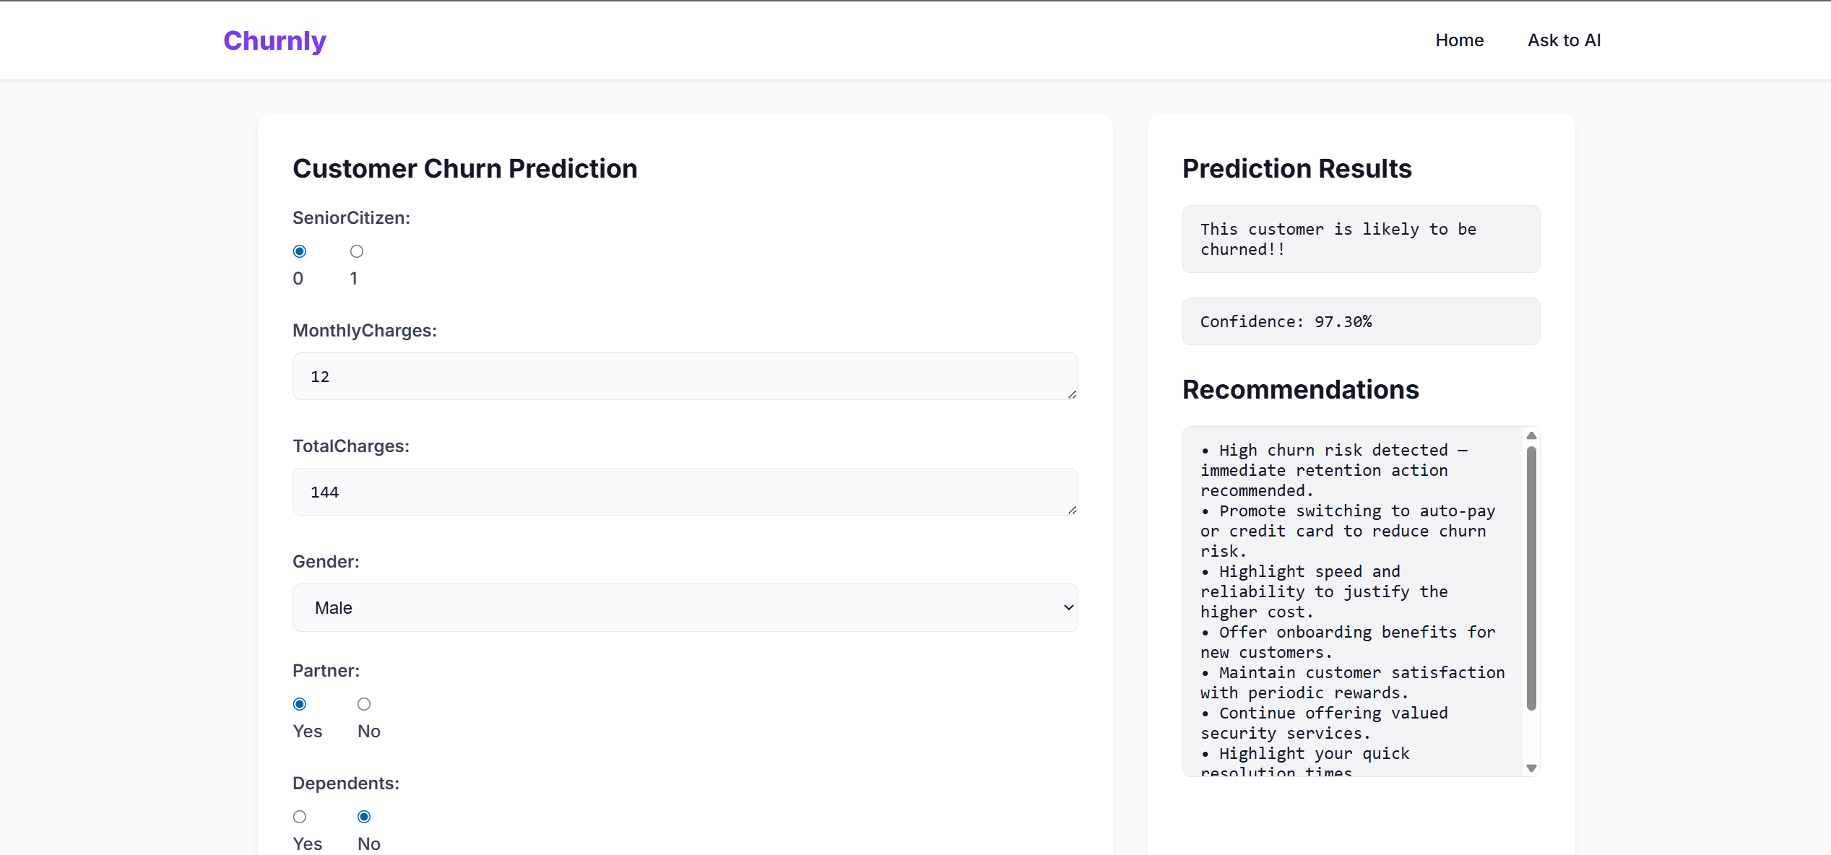
{Feature} Insights and Recommendations
Page-2 : Prediction Page {After Submission}

Slide 45
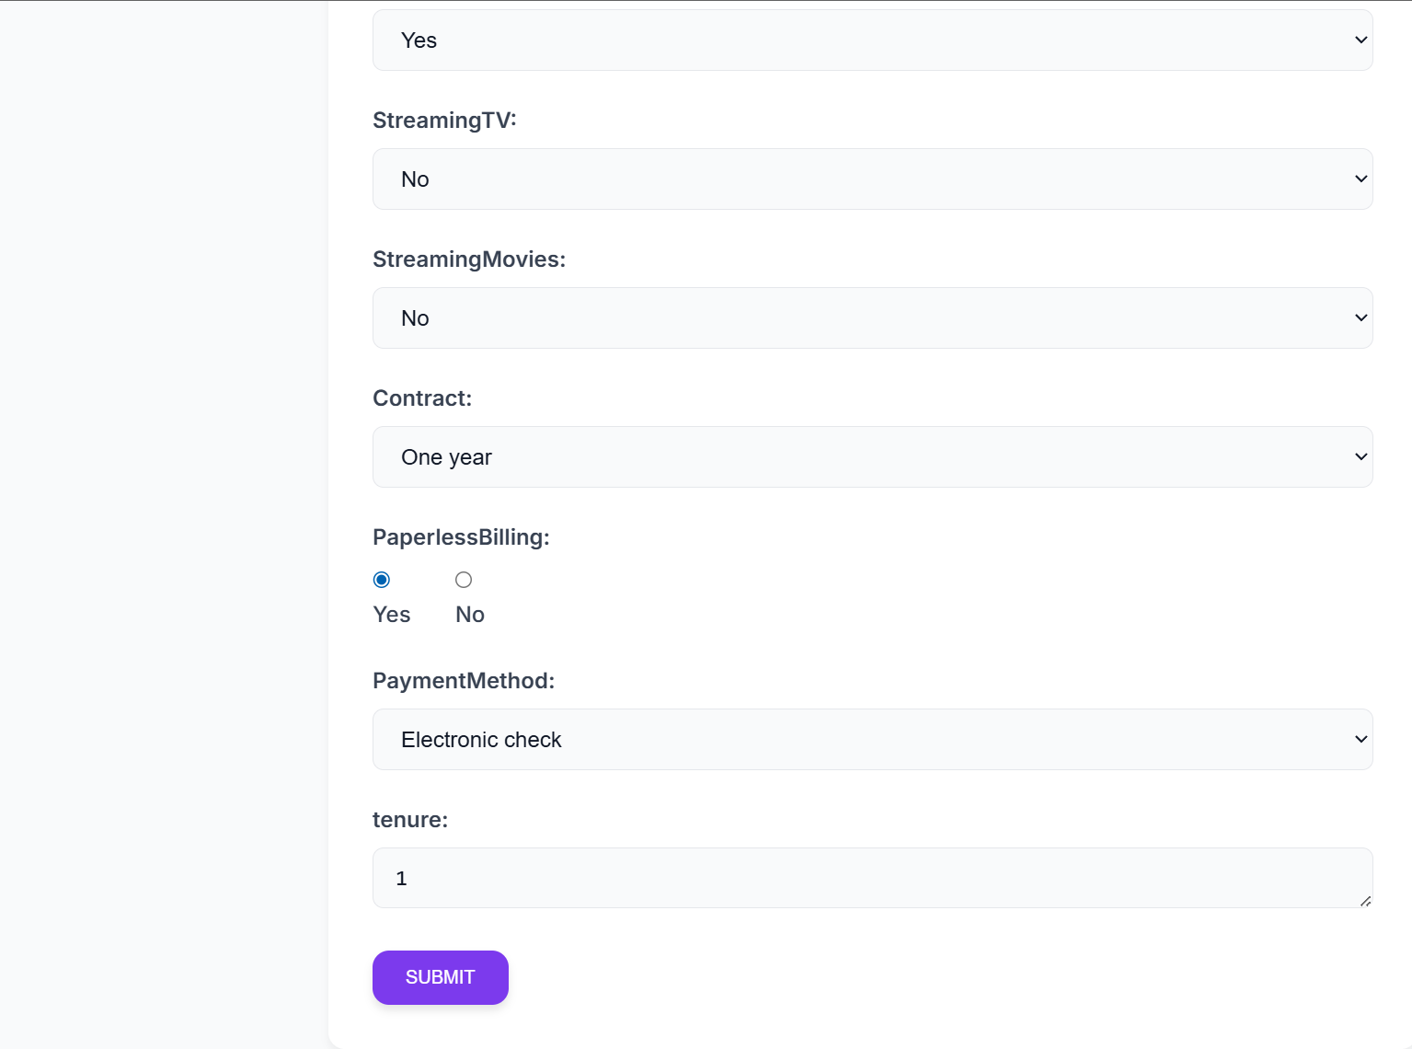
{Feature} Insights and Recommendations
Page-2 : Prediction Page {Continue}

Slide 46
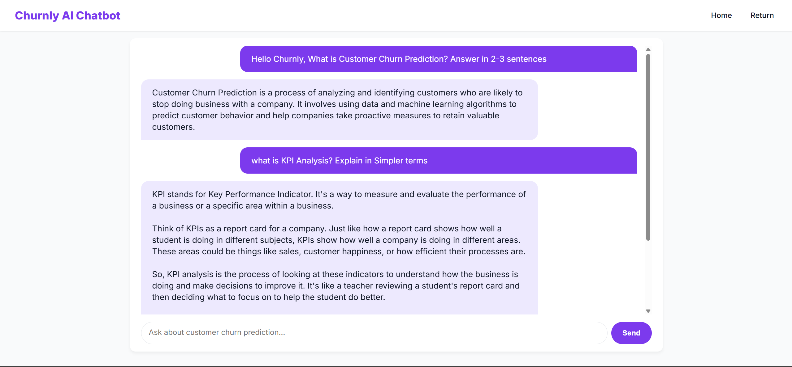
{Feature} Insights and Recommendations
Page-3 : AI Chat-Bot Page {After Response}

Slide 47
List of Research Papers
Sr No. | Research Paper
1. | CUSTOMER CHURN PREDICTION ANALYSIS IN A TELECOMMUNICATION COMPANY WITH MACHINE LEARNING ALGORITHMS*
2. | APPLICATION OF MACHINE LEARNING TO CUSTOMER CHURN RISK PREDICTION
3. | CUSTOMER CHURN IN SUBSCRIPTION BUSINESS MODEL—PREDICTIVE ANALYTICS ON CUSTOMER CHURN
4. | PREDICTION OF CUSTOMER CHURN BEHAVIOR IN THE TELECOMMUNICATION INDUSTRY USING MACHINE LEARNING MODELS
5. | CHURN PREDICTION USING MACHINE LEARNING AND RECOMMENDATIONS PLANS FOR TELECOMS
6. | CUSTOMER CHURN PREDICTION IN TELECOM USING MACHINE LEARNING IN BIG DATA PLATFORM
7. | A COMPARATIVE STUDY OF CUSTOMER CHURN PREDICTION IN TELECOM INDUSTRY USING ENSEMBLE BASED CLASSIFIERS
8. | CANCEL: A FEATURE ENGINEERING METHOD FOR CHURN PREDICTION IN A PRIVACY-PRESERVING CONTEXT
9. | HANDLING CLASS IMBALANCE IN CUSTOMER CHURN PREDICTION
10. | REAL TIME CUSTOMER CHURN SCORING MODEL FOR THE TELECOMMUNICATIONS INDUSTRY
Sr No. | Research Paper
11. | CUSTOMER CHURN PREDICTION
12. | A MULTI-LAYER PERCEPTRON APPROACH FOR CUSTOMER CHURN PREDICTION
13. | CUSTOMER CHURNING ANALYSIS USING MACHINE LEARNING ALGORITHMS
14. | PREDICTIVE ANALYSIS FOR CUSTOMER RETENTION
15. | METHODS AND SYSTEMS FOR IDENTIFYING CUSTOMER STATUS FOR DEVELOPNG CUSTOMER RETENTION AND LOYALTY STRATEGES
16. | RESEARCH ON CUSTOMER CHURN PREDICTION AND MODEL INTERPRETABILITY ANALYSIS
17. | CUSTOMER CHURN BEHAVIOR PREDICTION AND VISUALIZATION.
18. | INVESTIGATING CUSTOMER CHURN IN BANKING: A MACHINE LEARNING APPROACH AND VISUALIZATION APP FOR DATA SCIENCE AND MANAGEMENT.
19. | PREDICTIVE AND ANALYTICS USING DATA MINING AND MACHINE LEARNING FOR CUSTOMER CHURN PREDICTION.
20. | A STUDY ON CUSTOMER CHURN PREDICTION.

